Slide 1
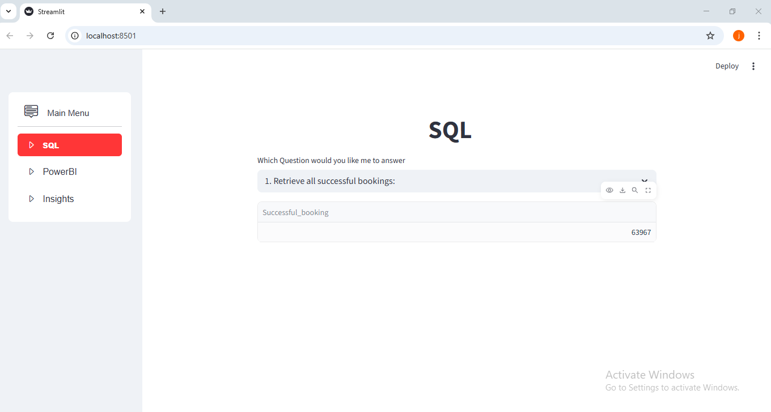
Streamlit_APP SQL
GitHub link for documents: https://github.com/mrjyothii/Labmentix_Projects

Slide 2
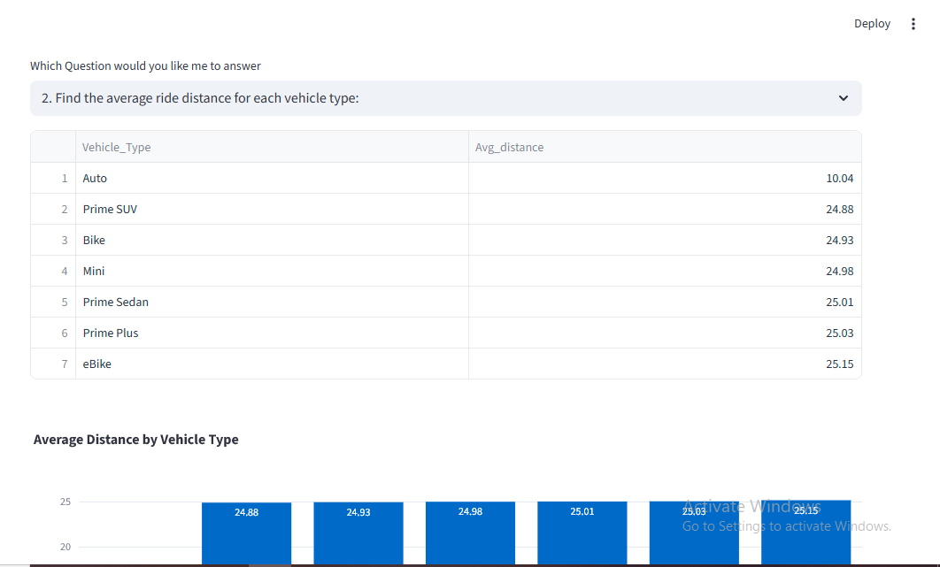
Streamlit_APP screenshots

Slide 3
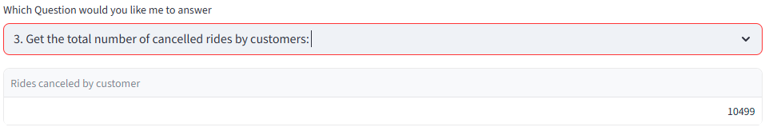
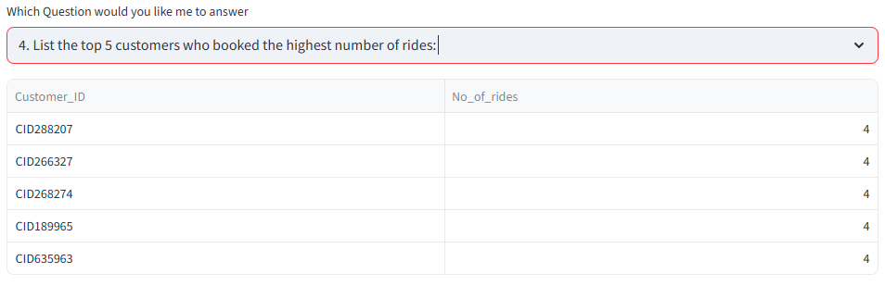
Streamlit_APP screenshots

Slide 4
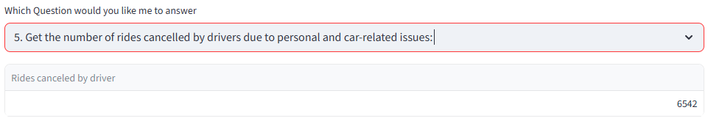
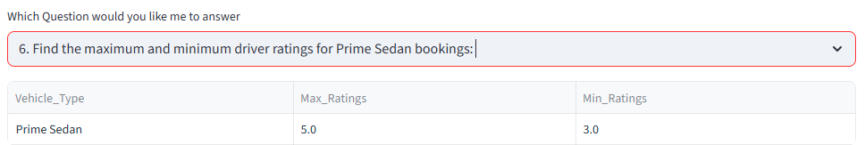
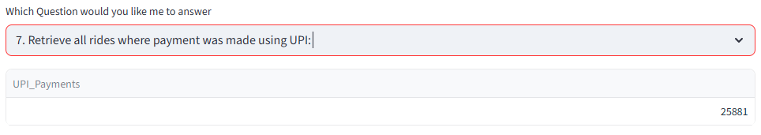
Streamlit_APP screenshots

Slide 5
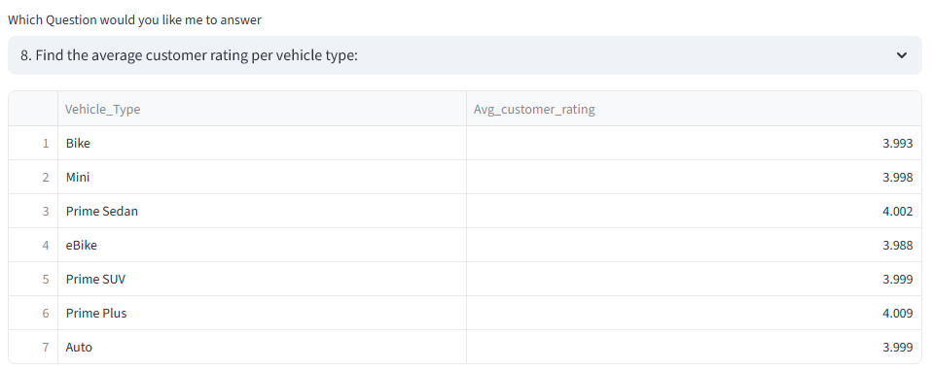
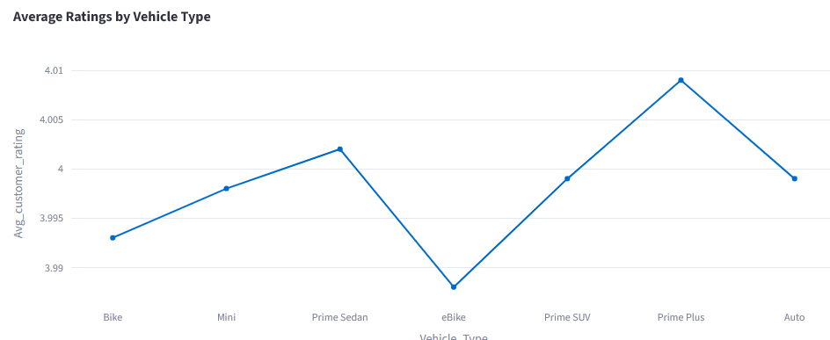
Streamlit_APP screenshots

Slide 6
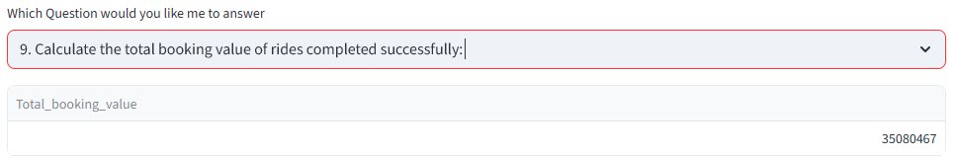
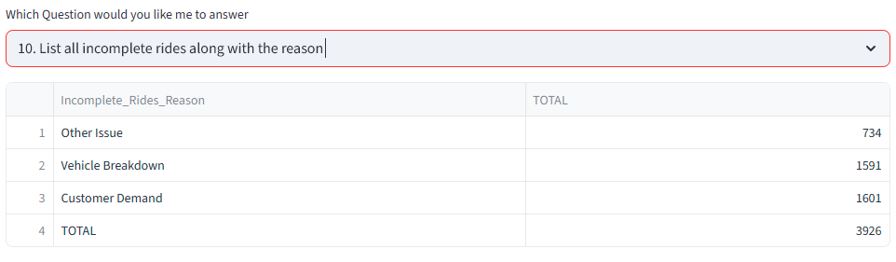
Streamlit_APP screenshots

Slide 7
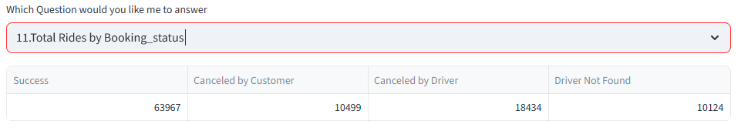
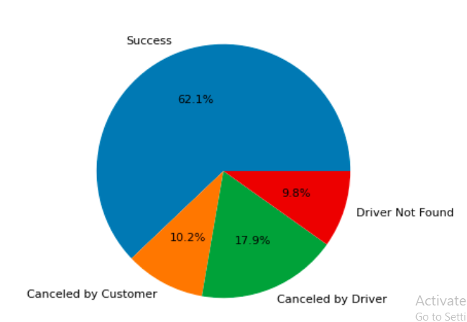
Streamlit_APP screenshots

Slide 8
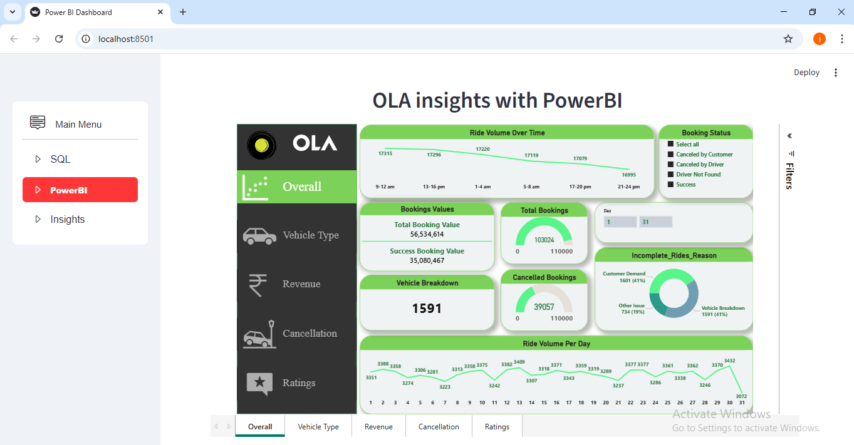
Streamlit_APP PowerBI screenshots

Slide 9
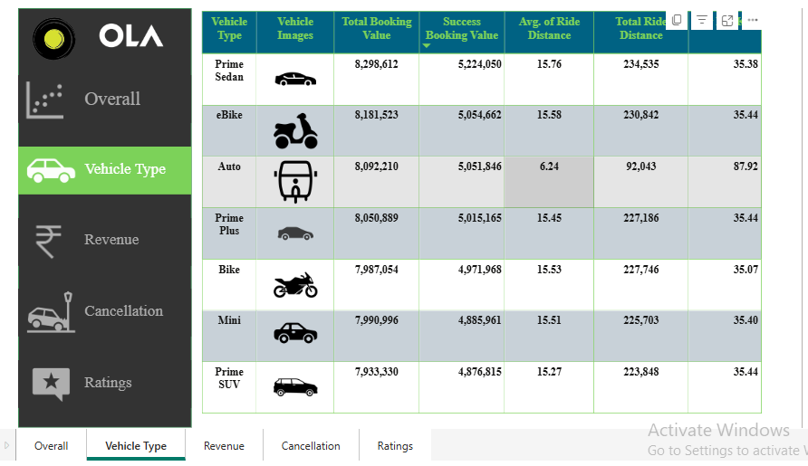
Streamlit_APP PowerBI screenshots

Slide 10
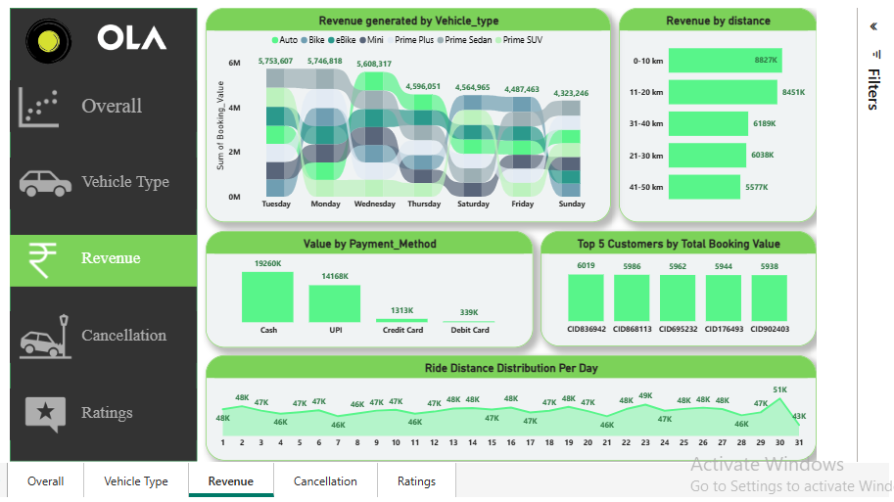
Streamlit_APP PowerBI screenshots

Slide 11
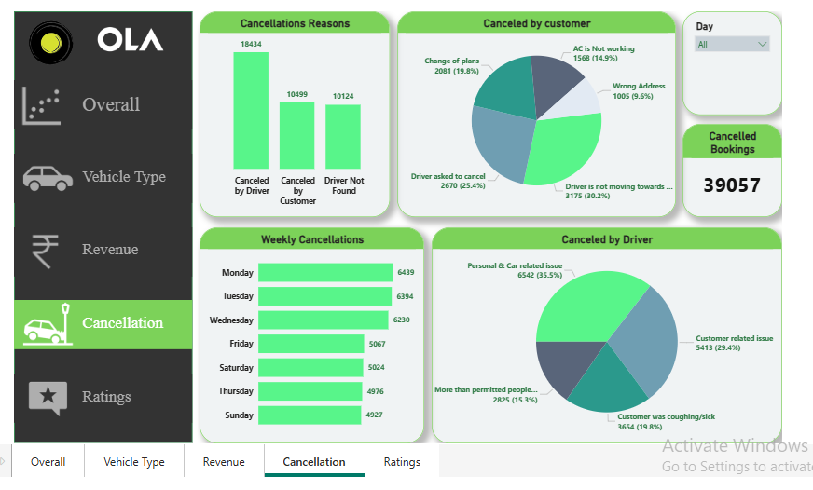
Streamlit_APP PowerBI screenshots

Slide 12
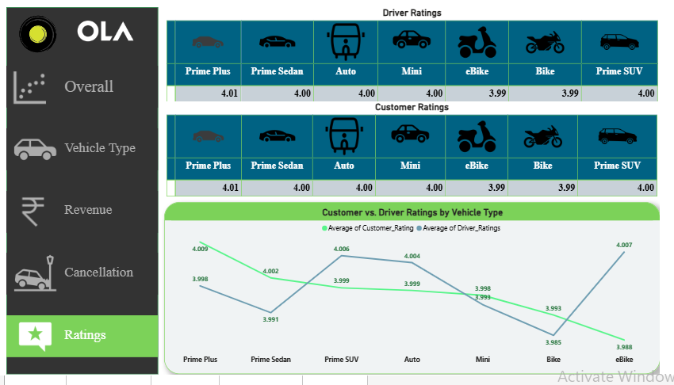
Streamlit_APP PowerBI screenshots

Slide 13
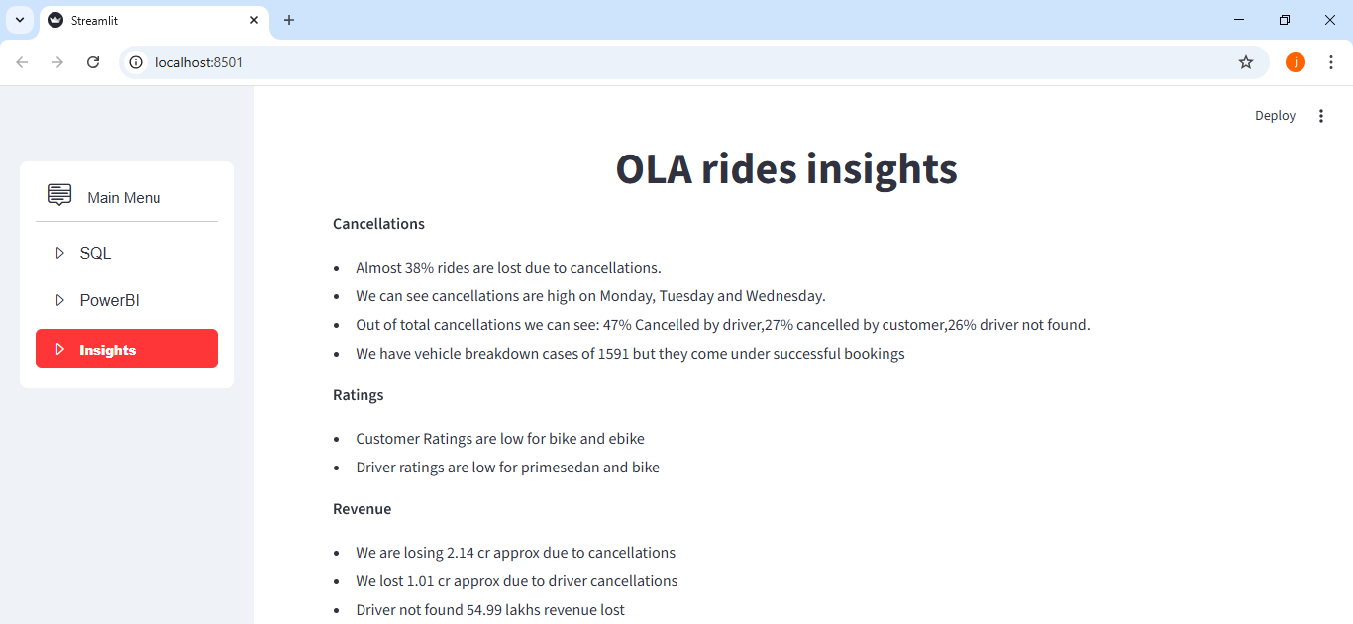
Streamlit_APP screenshots

Slide 14
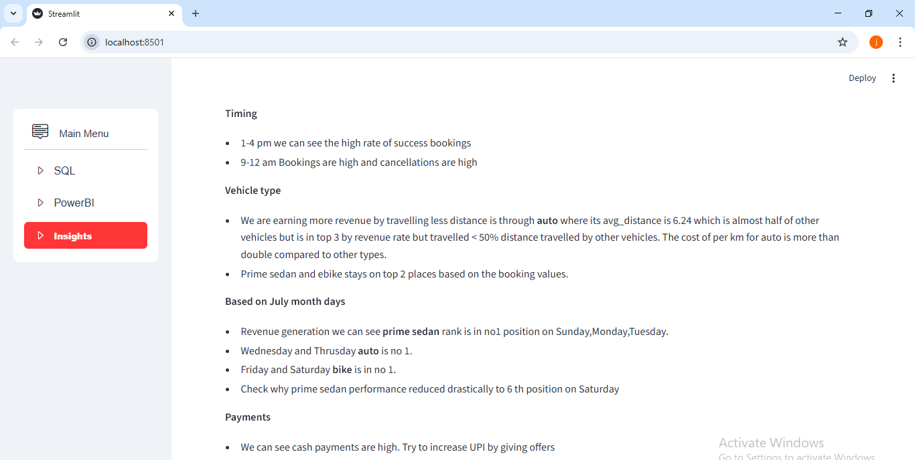
Streamlit_APP screenshots

Slide 15
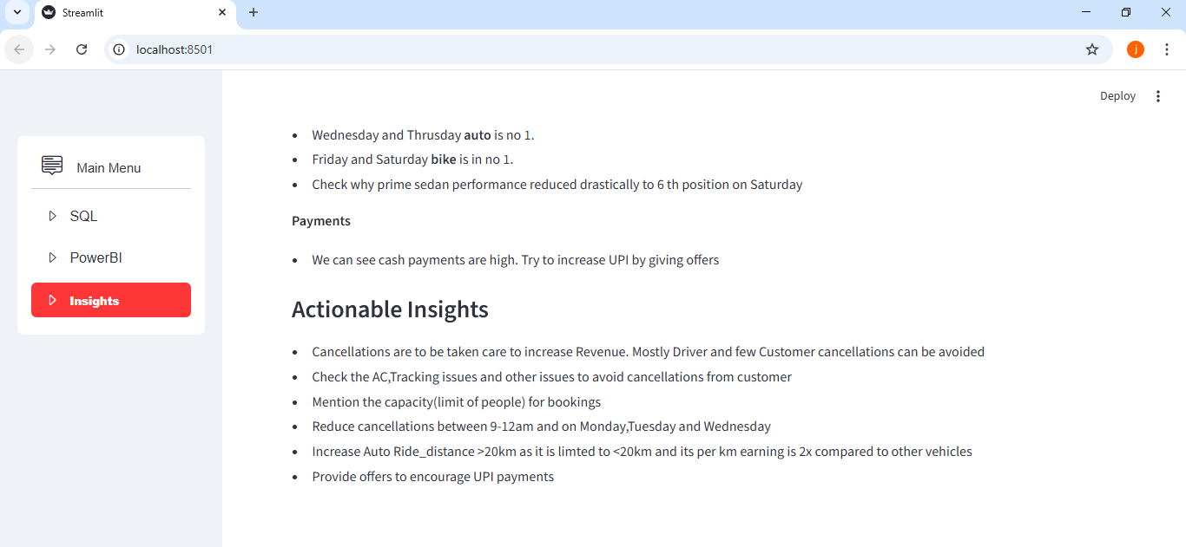
Streamlit_APP screenshots

